Slide 1
Retroactive interference in recognition memory The roles of mental effort, consolidation, and similarity
Caleb J. Picker
Psychology Department
University of Nevada, Las Vegas

Slide 2
Consolidation
Adapted from Dewar, Cowan, & Della Sala (2007)
Notes:
Presumably what happens when you study information is that over time, the information becomes strengthened, or cosnolidated

Slide 3
Recognition memory example experiment
Notes:
In a recognition memory xperiment, you might be required to study a list of word pairs.

Slide 4
Recognition memory example experiment
Intact or rearranged?
Notes:
In a recognition memory xperiment, you might be required to study a list of word pairs.
This tests relies on your ability to recollect which words was paired with which word, but how familiar each word feels will not help yo uon this test because all words have been studied before.

Slide 5
Retroactive interference example experiment
Intact or rearranged?
Notes:
If we made this a retroactive interference experiment, we might require subjects study new information during the retention interval. Interference is observed fi this new information affects memory for old information.
This project will be concerned with the nature of this interference.

Slide 6
Similarity of interference to studied materials
Mental effort
Reproduced from Skaggs (1925)
Notes:
This graph shows how varying the similarity of the new information to the old information results in an interplay between facilitation and interference. Ranging form a complete repetition, to something completely dissimilar high similarity produces the most facilitation, and decreasing similarity results in less facilitation. In contrast, interference at first increases to a peak point, and then continues to decrease afterward, but never to zero. This is because learning any kind of new information requires mental effort.

Slide 7
Mental effort and similarity
Adapted from Dewar, Cowan, & Della Sala (2007)
Notes:
Continuing on, the interference may be dissimilar or similar to the old information.

Slide 8
Mental effort and similarity
Adapted from Dewar, Cowan, & Della Sala (2007)
Notes:
Any time something new is learned, it takes mental effort. In addition, there may be a different mechanism by which similarity causes interference.

Slide 9
Mental effort and similarity
Adapted from Dewar, Cowan, & Della Sala (2007)
Notes:
Specifically, mental effort may disrupt consolidation, and the time point of disruption also matters.

Slide 10
Mental effort and similarity
Adapted from Dewar, Cowan, & Della Sala (2007)
Notes:
The sooner the disruption, the less time for consolidation, resulting in more interference.
In addition, the similarity of the old info to new info results in a confusion about the correct response at test. In addition, more similar items biases old and new items to feel more familiar.

Slide 11
What we know
Any mental activity/effort could potentially disrupt consolidation and cause interference (Muller & Pilzecker, 1900; Skaggs, 1925; 1931; Wixted, 2004)
The time point of disruption matters—mental activity that occurs immediately after study affects memory more because there is less time for consolidation (Wixted, 2004)
Similarity biases studied and interference items to feel familiar (Verde, 2004)
Notes:
Any mental effort may disrupt consolidation, and mental effort that occurs immediately after stdy causes more interference because fresher memories hae not had a chance to consolidate. In addition, similarity biases studied and interference items to feel familiar
Time point of disruption. Wixted (2004) noted that in the past, people manipulated the temporal point of interpolation for cue overload studies, but only did immediately after study or immediately before test. When other studies included a middle point (where, presumably, consolidation effects are minimized and competition is minimized), then they do find a temporal point of interpolation. Importantly, this logic occurs at the level of the LTP.

Slide 12
What we know
Fewer items recalled after learning new information than after rest (Muller & Pilzecker, 1900)
Mental effort involved in learning new information may disrupt consolidation (Muller & Pilzecker, 1900; Wixted, 2004) crucial for recollection-dependent recognition memory but not familiarity-dependent item recognition memory (e.g., sleep, Van der helm et al., 2011)
Similarity of new information to study materials results in more similar items in memory, biasing all items to feel familiar (Verde, 2004)

Slide 13
Research questions
1) Does mental effort selectively affect recollection?
2) Does decreasing the amount of time for consolidation cause more forgetting (i.e., small recollection estimates)?
3) Does similarity of new information affect recollection and feelings of familiarity?
4) How does having interference lures at test affect recollection and familiarity?

Slide 14
Experiment 1: Mental effort and time point of disruption
Research question
How does mental effort (compared to rest) and the time point of disruption affect memory?
Notes:
Experiment 1 will eamine mental effort and the time point of disruption on memory, and memory will be measured using estimates of recollection and familiarty.

Slide 15
Experiment 1 Design
Notes:
Paticipants will first study a list of word pairs

Slide 16
Experiment 1 Design
Notes:
And then they wil be given a 30 minute retention interval during which different types of interference will make their appearance, presented at different time points.

Slide 17
Experiment 1 Design
Notes:
We will present interference either 0 mins

Slide 18
Experiment 1 Design
Notes:
10 mins

Slide 19
Experiment 1 Design
Notes:
Or 20 mins after study. And the interference will require different degrees of mental effort, manipulated using either easy or difficult math problems.

Slide 20
Experiment 1 Design
Notes:
This will be compared to a rest interval, and everything will be manipulated between-subjects, resulting in 7 conditions.

Slide 21
Experiment 1 Design
Notes:
Finally, participants will take a test

Slide 22
Experiment 1: Main effect of mental effort
Main effect of mental effort: If mental effort selectively affects recollection (but not familiarity), then more mental effort results in smaller recollection estimates.

Slide 23
Experiment 1: Main effect of time for consolidation
Main effect of time for consolidation: If interference is greater when presented immediately after study than later, then recollection estimates should be smaller in the 0 minute condition than in other conditions.

Slide 24
Experiment 1: Interaction
Effect of mental effort on recollection may depend on time point of disruption
Notes:
We expect that the effect of mental effort on recollection will depend on the time point of disruption. We do also predict main effects, but we are most interested in the interaction, and specifically the effects on recollection.
The x-axis shows the time point of disruption and the y-axis indicates the probability of recollection, ranging from 0 to 1, with a higher number indicating a higher likelihood of recollection.

Slide 25
Experiment 1: Tentative discussion
If obtained, these data would suggest that mental effort disrupts consolidation of old information crucial for the ability to recollect past information

Slide 26
Experiment 2: Skaggs-Robinson hypothesis
Reproduced from Skaggs (1925)
Notes:
The next experiment will look at varying the degree of the similarity of the new information to old information affects recollection and familairty.

Slide 27
Skaggs-Robinson hypothesis
Reproduced from Skaggs (1925)
Notes:
This graph will look at how the amount of facilitation or amount of interference is affected by similarity

Slide 28
Skaggs-Robinson hypothesis
Reproduced from Skaggs (1925)
Notes:
Varying the degree of similarity.

Slide 29
Skaggs-Robinson hypothesis
Reproduced from Skaggs (1925)
Notes:
This x-axis ranges from high similarity, or a repetition of an old stimulus, to

Slide 30
Skaggs-Robinson hypothesis
Reproduced from Skaggs (1925)
Notes:
Low similarity (e.g., math problem).

Slide 31
Skaggs-Robinson hypothesis
Reproduced from Skaggs (1925)
Notes:
Let’s first look at facilitation.

Slide 32
Skaggs-Robinson hypothesis
Reproduced from Skaggs (1925)
Notes:
Going from complete repetition to a math problem, we find that a benefit in memory performance decreases.

Slide 33
Skaggs-Robinson hypothesis
Reproduced from Skaggs (1925)
Notes:
In contrast, when we look at interference,

Slide 34
Experiment 2
Research questions
How does similarity affect recollection and familiarity estimates?
Is interference only observed when interference lures are incorrect answers at test?
Interference may only be observed if it telling apart studied and interference lures is required (Chandler & Gargano, 1998)
Notes:
So, our second experiment is interested in how similarity affects recollection and familairty, and how having interference lures on the test affects recollection and familiarity.
So what would happen if we varied the similarity, and what would happen if interference information was or was not presented at test?
It has been observed that we may only see interference effects if interference at test is required.
Chandler & Gargano (1998) actually showed that presenting nterference items at the same time at study (but not at test) resulted in a poor ability to discriminate between studied and new, but highly similar lures in an item recognition test. The idea is that it is hard to tell apart the items that were similar. But if there is a temporal separation, then it is easier to tell apart the interference from studied items, so even if that trace is more recently activated, it will not interfere. ON the other hand, if there is an associative recognition test, interference occurs more at test than at study because more recently activated traces compete for response selection, and those traces inhibit or block the other assocites through retrieval inducd forgetting. What this suggests that when discrimination between studied and interference is made difficult, interference is more likely to be observed. So we used a test that either had interference lures at test or not in order to determine whether this was the case. He also talks about Elizabeth Loftus’s arguments where a similar paradigm was used ,but interference was not observed. The argument eventually amounted to when the discrimination between intact and interference lures at test is required, interference is observed. Otherwise it isn’t.

Slide 35
Experiment 2 Design
Notes:
In this experiment, participants will study a list of picture pairs

Slide 36
Experiment 2 Design
Notes:
And then they will presented with interference materials, manipulated within subjects. The materials will vary in similarity.

Slide 37
Experiment 2 Design
Notes:
Ranging from complete repetition

Slide 38
Experiment 2 Design
Notes:
To decreasing dgrees of similarity (the chaise lounge changed colors)

Slide 39
Experiment 2 Design
Notes:
And less ismilar

Slide 40
Experiment 2 Design

Slide 41
Experiment 2 Design
Notes:
And finally a control condition where some materials are not interfered with.

Slide 42
Experiment 2 Design
Notes:
Then, there will be two tests, one that has interference items at test.

Slide 43
Experiment 2 Design
Notes:
Like this.

Slide 44
Experiment 2 Design
Notes:
Or one that does not

Slide 45
Experiment 2 Design

Slide 46
Experiment 2 Design
Notes:
Like this.

Slide 47
Experiment 2: Logic for test type
Logic for interference lures
Discrimination required between intact and interference lures, hurts performance because interference mistaken for old items
Recollection: hurt most at high similarity
Familiarity: greatest at high similarity
Logic for pair recognition (new lures)
Discrimination not required, benefits performance because interference mistaken for old items
Recollection: greatest at high similarity
Familiarity: greatest at high similarity

Slide 48
Experiment 2: Hypotheses for recollection
Interference lures
As similarity decreases, recollection at first decreases dramatically and then increases (because discrimination is difficult)
Pair recognition
As similarity decreases, recollection estimates should gradually decrease (because interference interpreted as repetition).

Slide 49
Experiment 2: Predicted results for recollection
Notes:
The x-axis depicts varying degrees of similarity ranging from repetition to control. The orange line indicates interference at test, and the purple indicates no interference at test.
We expect that repetition should result in a benefit in recollection estimates relative to a control.
However, when interference is required, recollection estimats should increase with decreasing similarity.
In contrast, when interference is not required, recollection estimates should steadily diecrease with decreasing similarity.

Slide 50
Experiment 2: Hypotheses for familiarity
Interference lures
More similar items in memory biases all item to feel familiar (leading to larger familiarity estimates at greater degrees of similarity)
Pair recognition
Same as above, except familiarity estimates should be larger overall (because familiarity can contribute more to performance)

Slide 51
Experiment 2: Predicted results for familiarity
Notes:
Familairty follows a different story. We expect that having more similar items in memory biases all items tof feel familiar, resulting in larger familiarity estimates.
So we expect that decreasing similarity results in decreasing familairty estimates.
We expect a main effect of test ype because familiarity may contribute more to pair recognition udgments than interference lure judgments overall.

Slide 52
Experiment 2: Tentative discussion
Interference lures versus pair recognition
Recollection hurt most at high similarity only when discrimination between studied and interference lures is required
More similar items in memory simply biases participants to think all items are familiar

Slide 53
Theoretical and broader implications of predicted results
Theoretical implications
Mental effort is a source of variance in everyday forgetting tat depends on time point of disruption (that seems to selectively affect recollection!) (Wixted, 2004)
Similarity affects recollection discrimination only when such discrimination is required; biases feelings of familiarity (Verde, 2004)
Broader implications
Allowing people (e.g., students or patients with amnesia) time to consolidate information without engaging in subsequently mentally effortful material should enhance likelihood of recollection
Low similarity of new information increase likelihood of recollection discrimination and reduces errors due to familiarity
Notes:
Therefore, the amount of interference may depend upon mental effort and the time point of disruption, as well as the degree of similarity
Some broader implications are that giving people time to consolidate information with less subsequent mental effort should reduce interference, which may be beneficial in learning environmental and understanding some amnesias.
In addition, having low similarity information could also enhance memory.

Slide 54
Acknowledgments
Advisor
Colleen M. Parks
Graduate student peers
Wei An
And others
Friends and family
My audience (you!)
Notes:
I’d like to acknowledge all those on this slide who have helped me.

Slide 55
Thank you!
Notes:
Thank you.

Slide 56
Outline
Recollection and familiarity
Mental effort and consolidation
Experiment & Predicted results

Slide 57
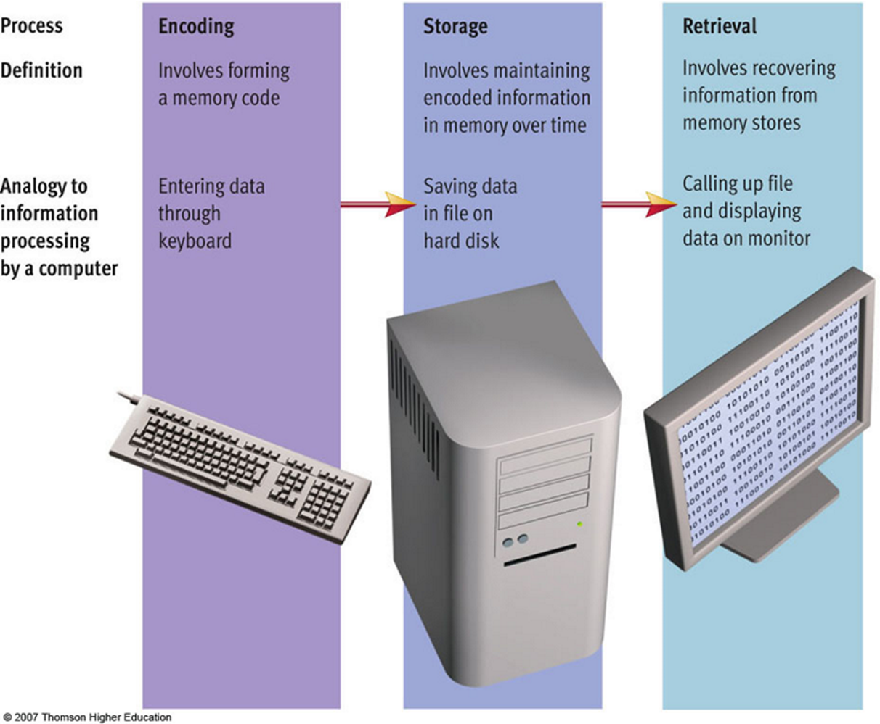
Definition of memory
Memory is the ability to encode, store, and retrieve different types of information
Weiten (2008)

Slide 58
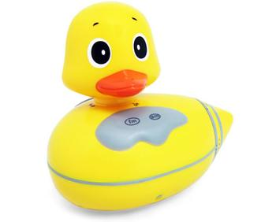
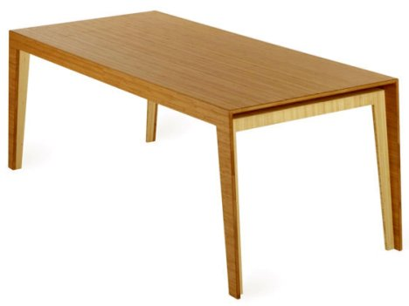
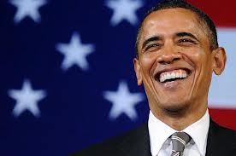
Recognition memory processes
Helps you recognize the difference between old and new events, and recognition depends on recollection of past details and familiarity for old and new events
Random things
Where you left your coffee mug
Recognize the president

Slide 59
STUDY

Slide 60
Remember these two paired together

Slide 61
Remember these two paired together

Slide 62
Research question
how does learning new and different types of interpolated information affect your ability to recognize past associations?

Slide 63
Mentally solve these problems

Slide 64
Mentally solve these problems

Slide 65
Mentally solve these problems

Slide 66
Mentally solve these problems

Slide 67
how pleasant are these two paired together?

Slide 68

how pleasant are these two paired together?

Slide 69
Remember these two paired together

Slide 70
how pleasant are these two paired together?

Slide 71
how pleasant are these two paired together?

Slide 72
how pleasant are these two paired together?

Slide 73
how pleasant are these two paired together?

Slide 74
how pleasant are these two paired together?

Slide 75
how pleasant are these two paired together?

Slide 76
TEST

Slide 77
Did you see these together at study?

Slide 78
Did you see these together at study?

Slide 79
Did you see these together at study?

Slide 80
Did you see these together at study?

Slide 81
Did you see these together at study?

Slide 82
Did you see these together at study?

Slide 83
Did you see these together at study?

Slide 84
Did you see this before?

Slide 85
Did you see this before?

Slide 86

Did you see this before?

Slide 87
Did you see these paired together?

Slide 88
END TEST

Slide 89
Familiarity and recollection
You probably felt that older items were more familiar than newer items (familiarity)
You probably recollected the ‘rubber duck’s’ bounce entrance (recollection)
Even though you saw the ‘duck’ and ‘mouse’ before, you had to use recollection to answer whether they were associated before

Slide 90
Forgetting
If I tested you a year from now, what would cause you to forget the rubber duck, President Obama, and other information contained in this lecture?

Slide 91
Outline
Recollection and familiarity
Mental effort and consolidation
Experiment & Predicted results

Slide 92
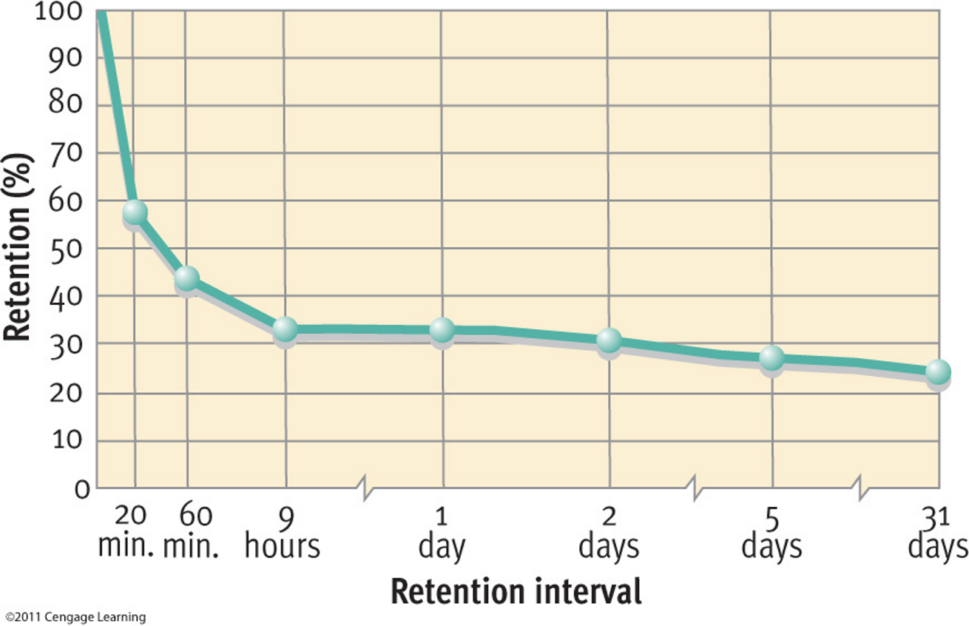
Forgetting curve
Forgetting is the loss of once-retrievable information (Wixted, 2010)
Weiten (2008)

Slide 93
Consolidation and retroactive interference
Rate of forgetting slows down over time, suggesting information in memory is somehow strengthened (consolidation)
Previously learned information is forgotten because of learning new information (retroactive interference)
Retroactive interference (RI) is greatest when there has been less time for consolidation

Slide 94
Mental effort and recollection
Mental effort may affect consolidation processes (Wixted, 2004; 2005; 2010) crucial for recollection
- Sleep enhances recollection-dependent source recognition memory but not familiarity-dependent item recognition memory (van der elm … , 2011)
- Blocking new learning with a drug enhances memory for old information (Reder et al., 2007)
Notes:
Similarity affects recollection discrimination and biases all items to feel familiar (Verde, 2004)

Slide 95
Experiment 2: Design

